Slide 1
Sorting and Searching Algorithms
Aymane Ouahbi, Khalid Samaoui

Slide 2
Summary
Sorting Algorithms:
Bubble Sort
Selection Sort
Insertion Sort
Merge Sort
Counting Sort
Quick Sort
Heap Sort
Searching Algorithms:
Linear Search
Binary Search
Jump Search
Interpolation Search

Slide 3
Bubble Sort
Main Idea:
Repeatedly swap the adjacent elements that are in the wrong order.
https://www.youtube.com/watch?v=xli_FI7CuzA&ab_channel=MichaelSambol

Slide 4
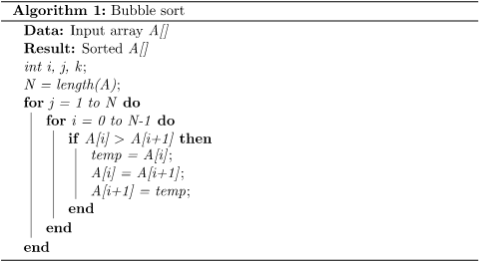

Slide 5
Selection Sort
Main Idea:
Sort an array by repeatedly finding the minimum element in the unsorted array an place it at the beginning.

Slide 6
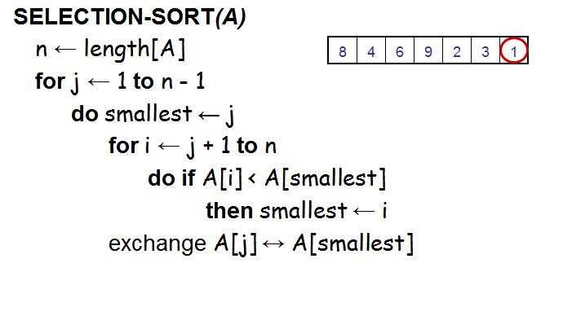

Slide 7
Insertion Sort
Main Idea:
Insertion sort is a simple sorting algorithm that works similar to the way you sort playing cards in your hands.
The array is virtually split into a sorted and an unsorted part. Values from the unsorted part are picked and placed at the correct position in the sorted part.

Slide 8
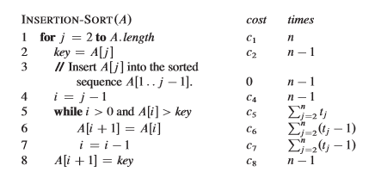

Slide 9
Quick Sort
Like Merge Sort, QuickSort is a Divide and Conquer algorithm. It picks an element as pivot and partitions the given array around the picked pivot.
The key process in quickSort is partition(). Target of partitions is, given an array and an element x of array as pivot, put x at its correct position in sorted array and put all smaller elements (smaller than x) before x, and put all greater elements (greater than x) after x. All this should be done in linear time.

Slide 10
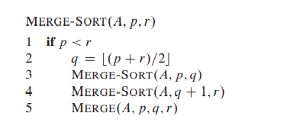
Merge Sort
Main Idea: (Divide, Conquer and Combine)
It divides the input array into two halves, calls itself for the two halves, and then merges the two sorted halves.

Slide 11
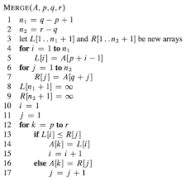

Slide 12
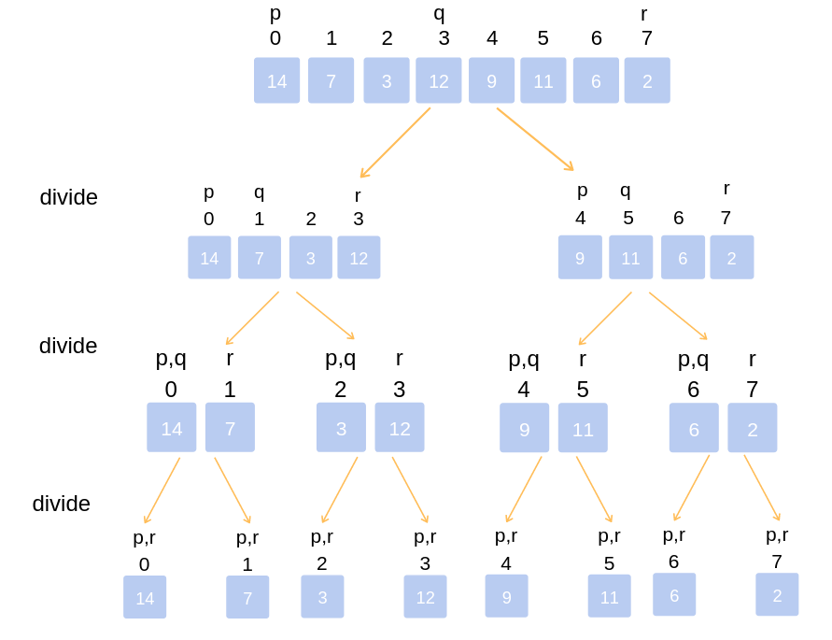

Slide 13
Counting Sort
Main Idea:
It works by counting the number of objects having distinct key values (kind of hashing). Then doing some arithmetic to calculate the position of each object in the output sequence.

Slide 14
